Slide 1
Circular Pie ER Diagrams

Slide 2
Team 5 : Circular Pie List of Entities
Entity Name | Entity Primary Attributes
Customer | customer_id, first_name, last_name, email, phone_number, Address, zip_code
Order | order_id, restaurant_id, coupon_code, customer_id, order_date, order_status, total_price, special_intructions
Pizza | pizza_id, pizza_size, protein, toppings, order_id
Delivery | delivery_id, order_id, driver_name, driver_phone_number, delivery_address, zip_code, delivery_status
Payment | payment_id, order_id, payment_date, payment_method, amount
Partner_restaurant | restaurant_id, restaurant_name, address, phone_number, zip_code, email
Advertiser | advertiser_id, company_name, contact_person_name, contact_person_phone_number, contact_person_email, ad_start_date, ad_end_date, ad_cost, paid, payment_id
Coupon | coupon_code, discount, max_amount, expiry_date
Zone_map | zip_code, restaurant_id, restaurant_zip_code
Order_Pizza | order_id, pizza_id
Customer_support | support_id, order_id, customer_id, query_title, query_desc, query_date, query_status, query_resolution_date

Slide 3
Team 5 : Circular Pie Conceptual ER Diagram
email
customer_id
phone_number
special_instructions
total_price
toppings
pizza_id
order_date
protein
first_name
customer_id
pizza_size
order_id
Customer
PLACES
restaurant_id
Pizza
last_name
HAS
order_id
Order
HAS
address
MAKES
payment_date
order_status
email
restaurant_id
zip_code
payment_method
coupon_code
APPLIES
Partner_restaurant
restaurant_name
TRACKS
payment_id
Payment
MAKES
provides
coupon_code
address
discount
HAS
REDUCES
order_id
amount
zip_code
phone_number
Coupon
Delivery
order_id
customer_id
HAS
support_id
ad_start_date
expiry
company_name
advertiser_id
ad_end_date
max_amount
delivery_address
order_id
Customer_support
company_name
restaurant_id
delivery_id
query_title
Advertiser
Zone_map
delivery_status
contact_person_name
query_resolution_date
restaurant_zip_code
zip_code
driver_name
contact_person_phone_number
ad_cost
query_date
query_desc
zip_code
driver_phone_number
query_status
zip_contact_person_email
paid
payment_id

Slide 4
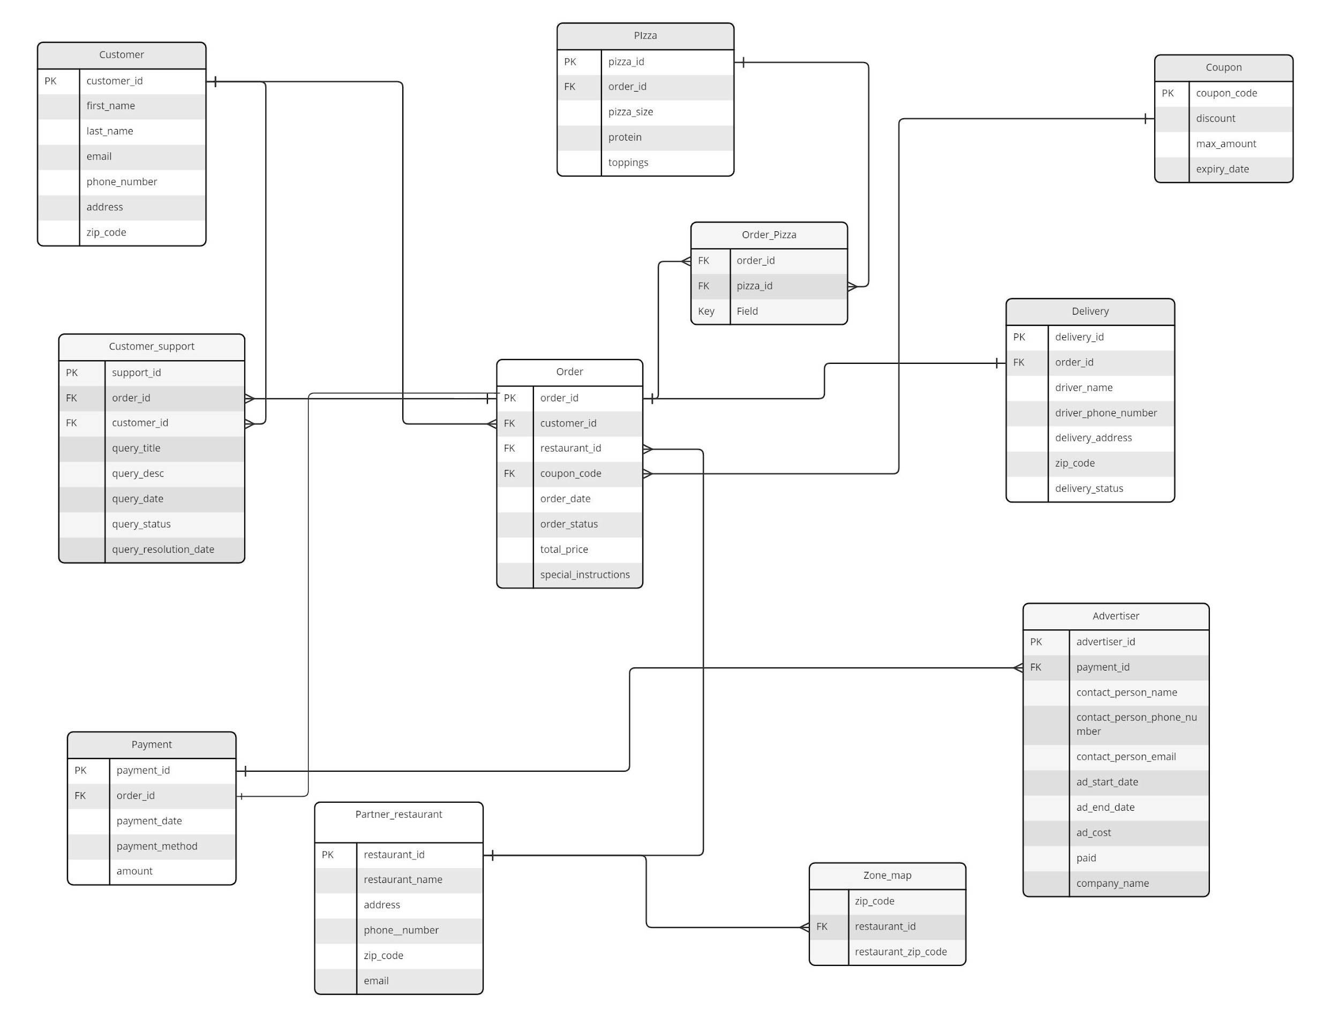
Team 5 : Circular Pie Logical ER Diagram

